Slide 1
Analisa Proses Kill Bots dalam Mempertahankan dari Serangan Denial of Service dengan
Menggunakan Struktur Data Bloom Filter
IAN FEBRIAN - 209115870

Slide 2
Content
Background
Objective
Scope
Distributed Denial of Service
Apache Development
Bloom Filter
Kill Bots
Result System Testing
Conclusion

Slide 3
Background
Denial of Service using botnets
Bandwidth flood attack that mimic the Web browsing behavior of large number of clients

Slide 4
Objective
Analyze the authentication process of Kill Bots
Learn more about what is Bloom Filter

Slide 5
Scope
The media to implement Kill Bots is Apache Web Server v1.7.1
Bloom filter is implemented in basic structure
Distributed Denial of Service Flash Crowd attack is used
Attack will be launch at port 80

Slide 6
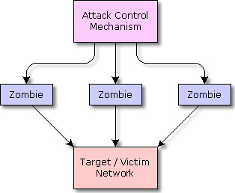
Distributed Denial of Service

Slide 7
What is Denial of Service?
The goal is to make server busy, or even overload
Use single computer
Make a connection from random port

Slide 8
How About The Distributed Part?
Same goal, but getting stronger
One computer as a brain, and the other one are the worker
Untraceable main artist
A lot of worker, as long as the worm spreads

Slide 9

Apache Development

Slide 10
Apache Web Server
Well Known Web Server
Free and Powerful
Module Based Server

Slide 11
Apache Development
Use an extra package (devel pack)
Only at UNIX Based Operating System
C is the main language
Perl is the second main language
Has own compiler called APXS (APache eXtenSion tool)

Slide 12
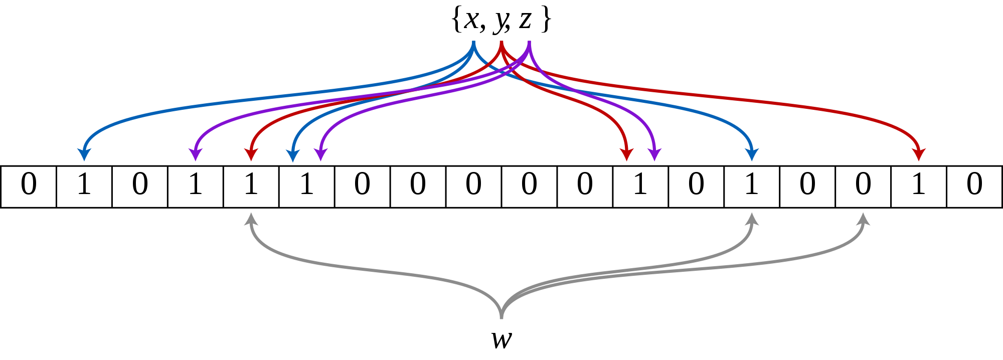
Bloom Filter

Slide 13
What is Bloom?
A filter data structure based on Hash Function
Fast process with minimum effort
Playing with Bit or Binary number, and array index

Slide 14
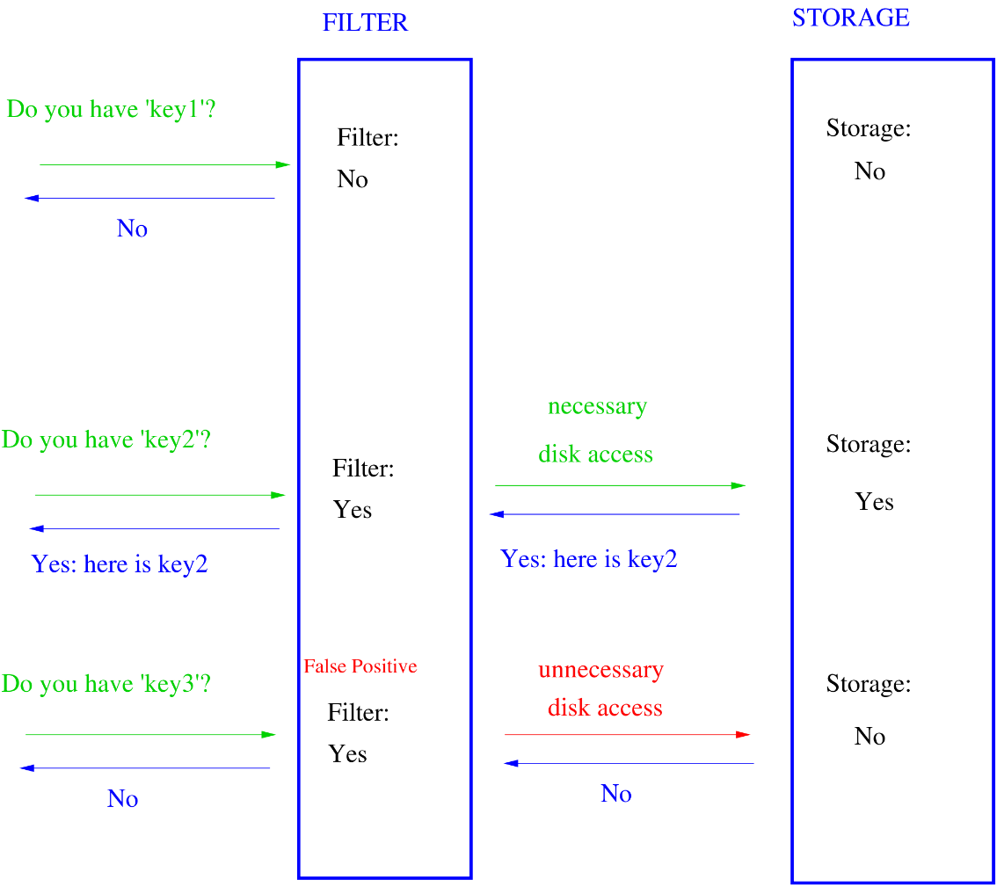
Bloom in The Application

Slide 15
Kill-Bots
Surviving BotNet
Attacks that Mimic
Flash Crowd

Slide 16



What is Kill Bots?
Authentication Process to define whether it is zombie or legitimate user

Slide 17
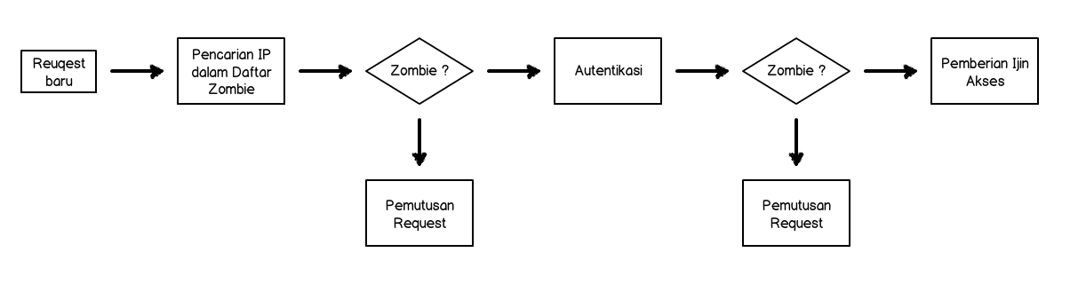
Architecture of Kill Bots

Slide 18
Transition Status
LOAD >= K₁
NORMAL
SUSPECTED
LOAD <= K₂ < K₁

Slide 19
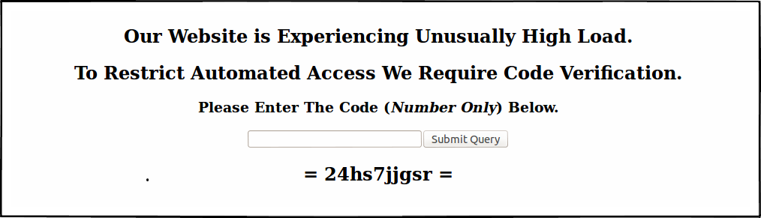
CAPTCHA

Slide 20

Secret Token

Slide 21
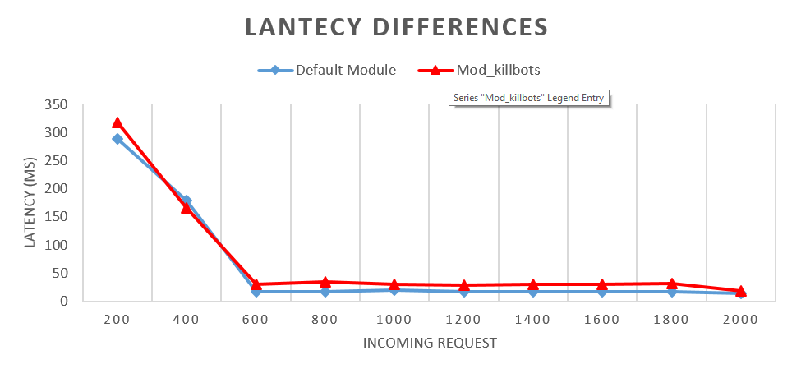



Result System Testing

Slide 22
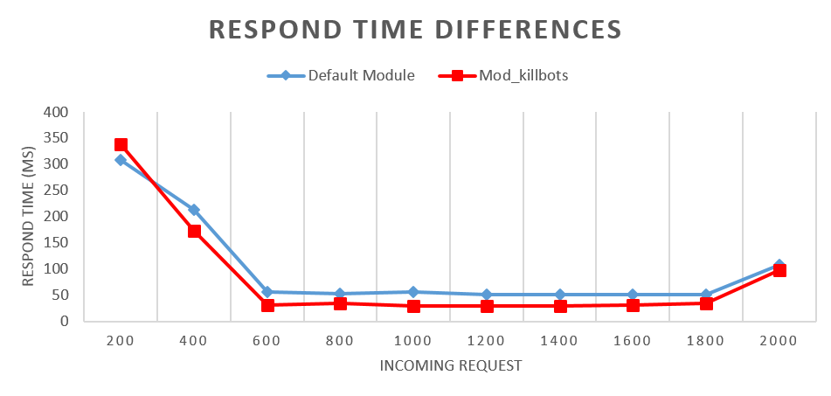
Result System Testing

Slide 23
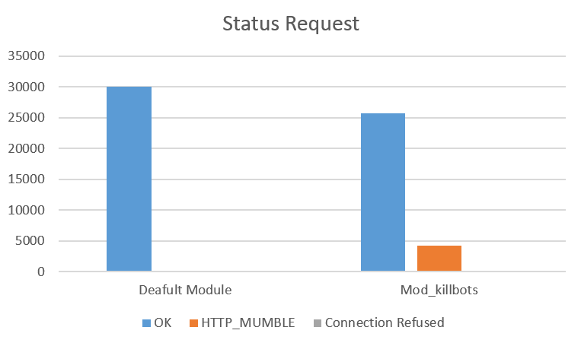



Result System Testing

Slide 24
Conclusion
Kill Bots reduces the respond time from server to client
In the SUSPTECTED situation, Kill Bots will gives a new request captcha
To make Kill Bots more powerful, a authentication based on server performance is needed, such as microbench

Slide 25



